Slide 1
Configuring and Customizing Search
Module 7

Slide 2
Agenda
WSS vs. MOSS
OOTB Search
Administrate Search
Customize Search Options

Slide 3
MOSS Search is Awesome!
WSS Search is cool too!
Same technology behind both
WSS Search only works within the site collection
MOSS can crawl just about anything
Biggest difference?
WSS Search just runs
MOSS Search has lots of configuration options
Remember MOSS Search and SSP

Slide 4
How search works
Locates content
Loads protocol handler
Loads necessary ifilter
Word breaks the file
Writes info to index (physical file)
Writes property info to search db
Search honors security!

Slide 5
ifilters
Core Microsoft search technology
Allows SharePoint to index other file types
OOTB only indexes
Plain text files
Word, PowerPoint, Excel files
Places to find ifilters
File Manufacturer
3rd party web sites
www.ifilter.org has list of free ones
Notes:
WSS Install KB http://support.microsoft.com/kb/927675/en-us

Slide 6
Adding a new file type
Install appropriate ifilter
Add to SSP > Search Settings > File Types
Add custom icon file
..\12\template\xml\docicon.xml
Upload to ..\12\template\images (16x16)
Double check file type is not excluded for server
Central Admin > Operations > Blocked file types

Slide 7
Noise words
These are words that have no search value
Files located in two places
C:\program files\Microsoft Office Servers\12.0\data\applications\{guid}\config
C:\program files\Microsoft Office Servers\12.0\data\config
WSS change to
C:\program files\common files\Microsoft Shared\web server extensions\12\
Different version for each language
Noiseenu.txt for US English
Noiseneu.txt for neutral files

Slide 8
Thesaurus File
Allows expansion and replacement on queries
Can also effect search weighting
Files located in two places
C:\program files\Microsoft Office Servers\12.0\data\applications\{guid}\config
C:\program files\Microsoft Office Servers\12.0\data\config
WSS change to
C:\program files\common files\Microsoft Shared\web server extensions\12\
Different version for each language
Tsenu.xml for US English
Tsneu.xml for all files

Slide 9
Feature Breakdown – Content Sources
WSS – Just your SharePoint Site Collection
MOSS Standard– All of your SharePoint Sites at once and add things like
Exchange Public Folders
Other Web Sites
File Shares
Other SharePoint Sites
MOSS Enterprise – The BDC baby!

Slide 10
Feature Breakdown – Scopes
WSS not really – MOSS for sure.
What is a scope?
Notes:
Scopes are the way you can search a specific portion of your index. So instead of searching all of your index you could search just the HR site or just the Accounting Exchange Public Folder.
Scopes are built using rules. Rules include web address, property, or content source.

Slide 11
All Sites Scope *
SharePoint Sites, Exchange PF, File Shares, Web Sites, Etc
HR Scope
http://portal.tpg.local/hr
\\server\HR
Exchange PF HR
People Scope *
All people
F: Drive Scope \\server\share
* Automatically Created Scopes

Slide 12
Feature Breakdown – Scheduling
Indexing is one of the most resource intensive things you can do with SharePoint. Controlling when it happens can be key.
WSS – Does a full crawl once a day when you choose.
MOSS – Complete scheduling control. Full and incremental options.

Slide 13
Other MOSS only features
Detailed easy to use logs
Control over relevancy
Crawl Rules
Easy to grow out farm and off load roles
Management of properties and advanced search
Keywords and best bets
Search center and 11 search web parts
Detailed search reporting

Slide 14
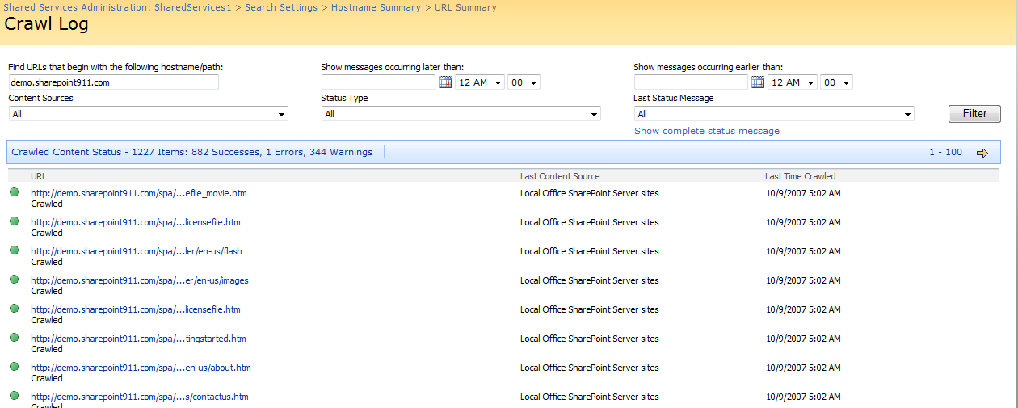
Gather logs
The place to figure out why search isn’t behaving
SSP > Search Settings > Crawl Logs

Slide 15
MOSS Includes 11 Search Web Parts
Create custom search solutions
Complete control over user search experience
Search center provides starting point
Part of Collaboration Portal Template

Slide 16
Keyword/Best bets
Highly under utilized
Keyword is what your user is searching for
Can assign a definition to display
Best bet is what you think they want
Links to any web url
Administered by site collection admin

Slide 17
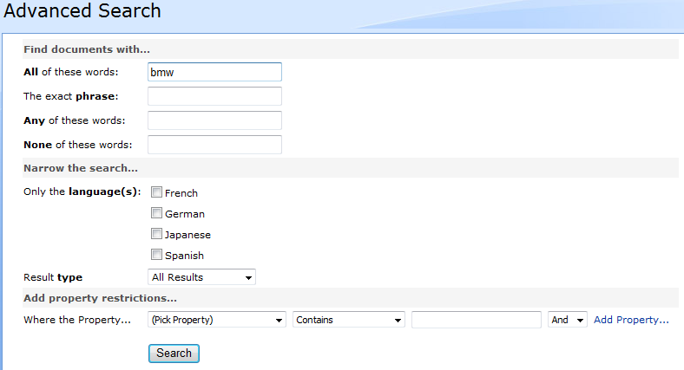
Advanced Search
Built with configurable Web Parts

Slide 18
Customizing Advanced Search
Add your own properties
SSP > Search Settings > Metadata Property Mappings
Edit Advanced Search Box WP
Properties section is XML
Add property definition
<PropertyDef Name=“YourProperty" DataType="text" DisplayName=“YourPropertyDisplayName"/>
Add property reference
<PropertyRef Name=“YourProperty" />

Slide 19
Other happy user features
Hit highlighting
Did you mean
Duplicate collapsing

Slide 20
Administrating Search
Central Administration
Define services/server roles
Proxy & Crawler impact rules
Site Collection
Keywords/best bets
Local scopes
The UI
SSP
Everything else

Slide 21
Search Reporting
Available from the SSP
Two types of reports
Search queries
Search results
Great feature for understanding your environment

Slide 22
Need to customize more?
Use XSLT and CSS to transform search results
Write code against Object Model or Web Services
Look to 3rd party
http://www.codeplex.com/FacetedSearch
Free Community Tool
http://www.ontolica.com/
Free Wild Card search/Pay full product
http://www.coveo.com
Replaces SharePoint Search Engine
http://www.ba-insight.net
Hit Highlighting, preview

Slide 23
The MOSS Search Service
Indexer Performance Setting | Total # of threads | Maximum # of threads per host*
Reduced | # of CPUs | # of CPUs
Partially Reduced | 4 times # of CPUs | # of CPUs plus 4
Maximum | 16 times # of CPUs | # of CPUs plus 4
* Can be increased to 64 per host with crawl rule
** 64 is maximum amount of the threads index can have at one time

Slide 24
Demo!
Everything search

